Slide 1
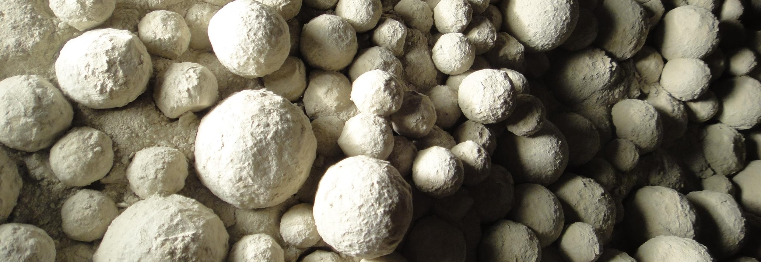
Case Study: Heat Balance - Solution
Drying and Cooling in Ball Mills and Separators

Slide 2
Content
Objectives
Problem description
Solution
Conclusion

Slide 3
Content
Objectives
Problem description
Solution
Conclusion

Slide 4
Objectives
Think about different possibilities to improve drying (or cooling) in an existing mill system
Recognize in a practical example the process limits regarding drying or cooling
Become familiar with the Holcim heat balance tool and learn, how to evaluate a heat balance on a ball mill system

Slide 5
Content
Objectives
Problem description
Solution
Conclusion

Slide 6
Description of Situation
In the Nowhere plant the product portfolio consists at present of a
OPC (3000 cm²/g / BDP 140 t/h) with 6 % of gypsum (moisture: 6 % wet basis) and 94 % of clinker
Limestone cement (3700 cm²/g / BDP 140 t/h) with 10 % of limestone (moisture: 6 % wet basis), with 6 % of gypsum (moisture: 6 % wet basis) and 84 % of clinker
Now, marketing wants to introduce a new slag cement type with 40 % of slag.
Slag cement (4700 cm²/g / BDP_{expected} 110 t/h) with 40 % of slag (moisture: 8 % wet basis) and with 6 % of gypsum (moisture: 6 % wet basis) and 54 % of clinker

Slide 7
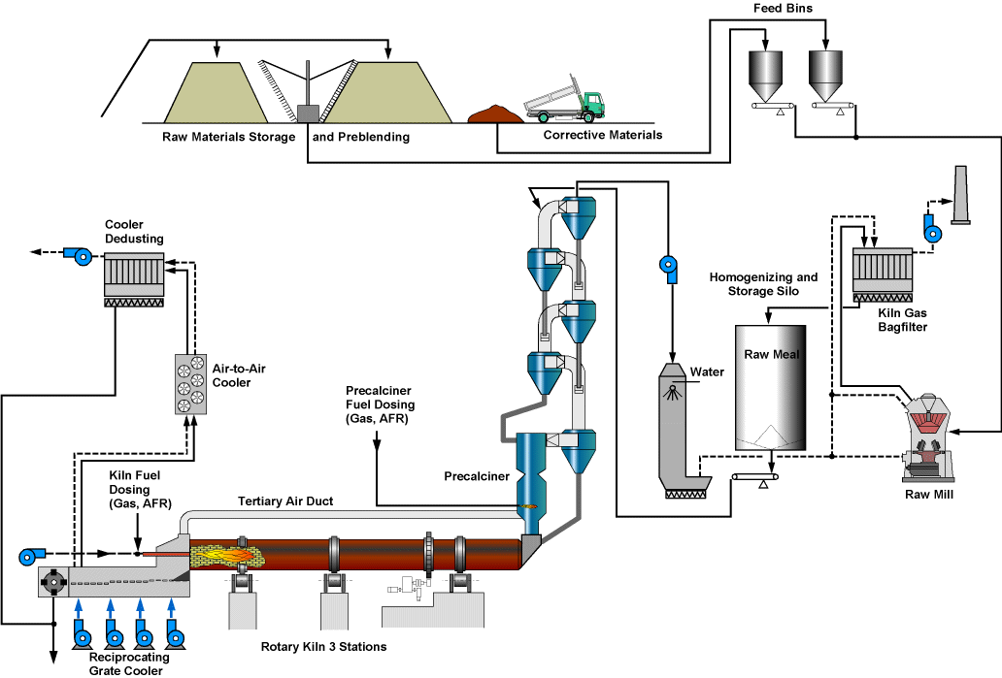
Kiln and Raw Mill Line Nowhere Plant

Slide 8
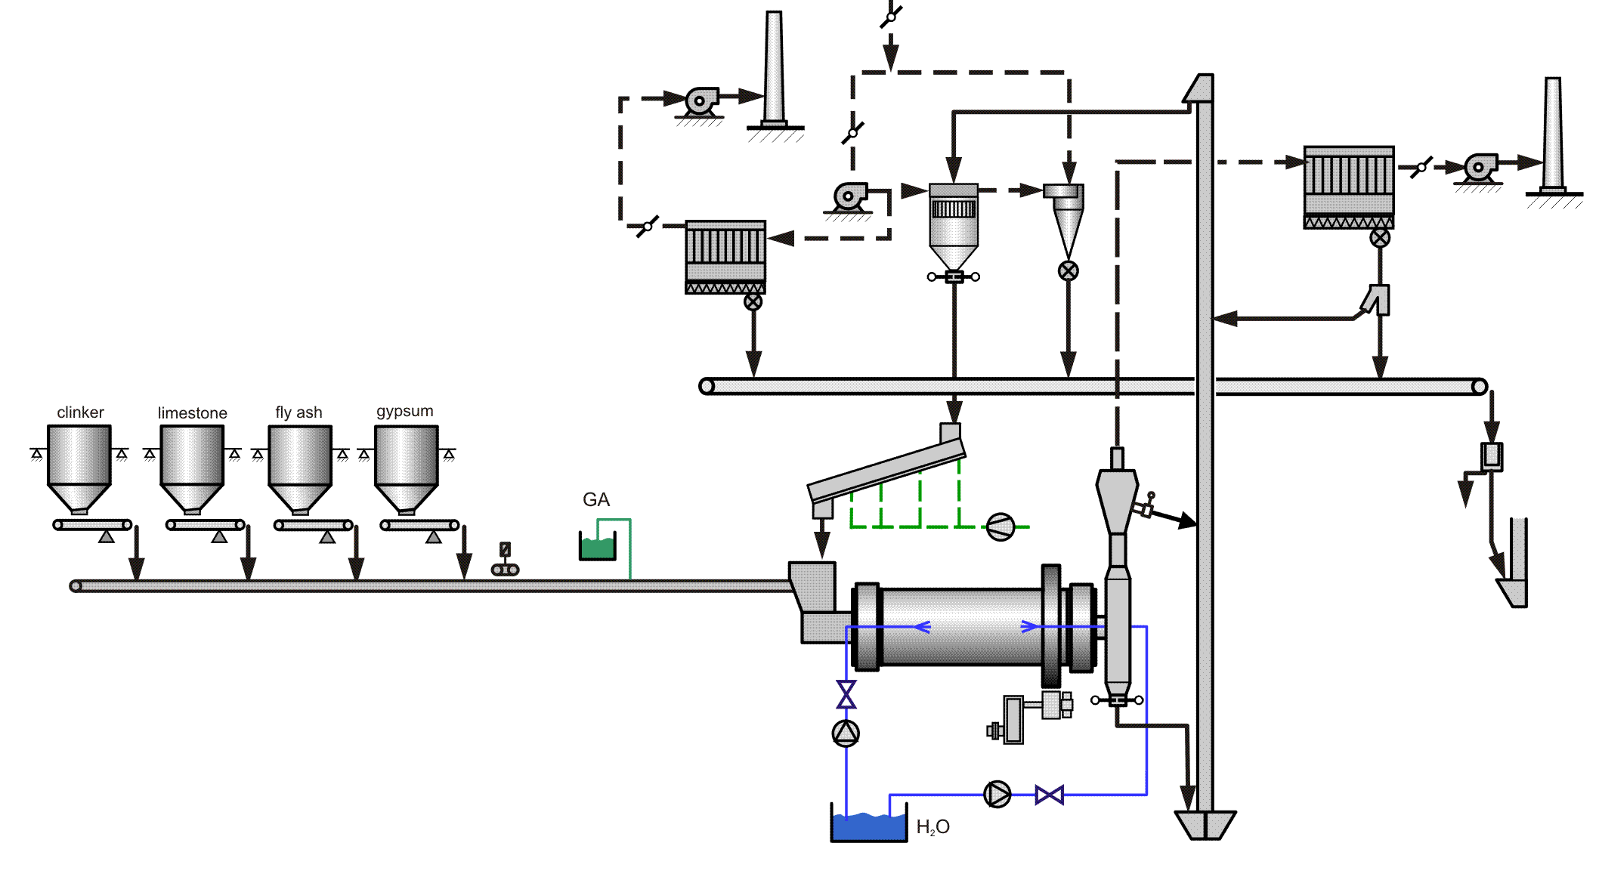
Cement Mill Nowhere Plant
clinker
limestone
gypsum
slag

Slide 9
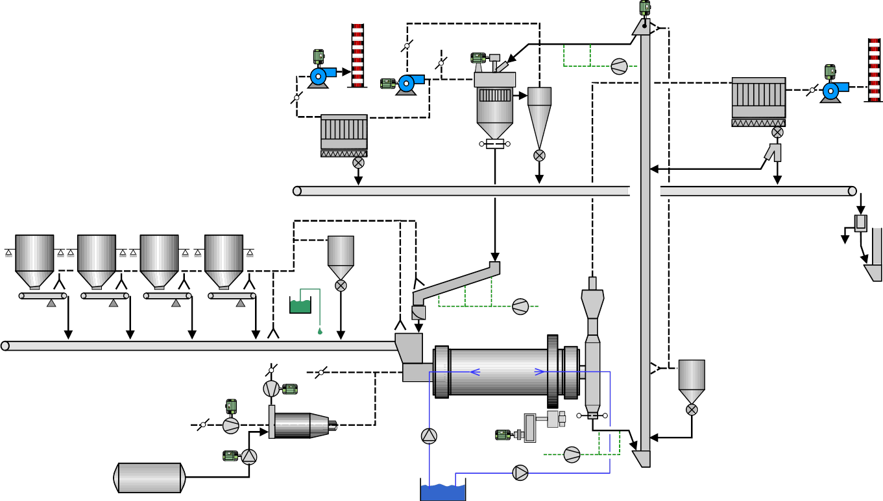
Cement Mill circuit details
Mill type | End Discharge Mill (EDM)
Installed power mill drive | 4000 kW
External heat source (e.g. HGG, kiln gas) | Not available
Ball mill filling degree | 1st Chamber: 30 % / 2nd Chamber: 30 %
Transmission type | Girth gear drive
Separator type | High Efficiency Separator with cyclone air system
Design capacity of bucket elevator | 570 t/h
Storage of clinker, gypsum and limestone | In storage hall – feed to mill with overhead crane
Storage of slag | Open storage now, but storage hall under construction
Feed rate limitations of mill feeding system | No limitations
Allowable average feed temperature of dosing and transport systems | max. 130 °C
Water injection system into mill | Installed, but pump broken

Slide 10
Task Description
Production of the Slag Cement:
Review the already completed heat balance program for the limestone cement scenario. Check, if the production of this slag cement with 40 % slag is feasible or not with the current mill system, only by optimizing the operational process parameters (e.g. mill and separator ventilation, mill feed temperature, …). No additional external heat source may be used.
If not, what is the maximum percentage of slag, which can be added?

Slide 11
Hints for the Task (Production of Slag Cement)
Check the following points, which may limit the drying potential for the production of this Slag Cement, if there is optimization potential or not (get detailed process data also from the EXCEL Heat Balance!!)
Excess moisture in the mill fresh feed
Low clinker temperature
Low clinker factor
High mill ventilation
Low circulating load
High fresh air rate in the separator
Low power consumption in the mill first grinding chamber

Slide 12
Hints for the Task (Production Capacity Increase)
The following, already existing equipment of the ball mill circuit will be no bottleneck for the 100 % increased production capacity
High Efficiency Separator
Bucket elevator from ball mill to HES
Cement transports from mill to silo
Silo capacity
Space in the cement mill building

Slide 13
Content
Objectives
Problem description
Solution
Conclusion

Slide 14
Identified causes that limit the drying capacity
Yes – with 40% slag feed moisture will be 3.6%!
(max. feed moisture < 2.5 – 3.0 % without external heat source)
Different root causes are possible:
Excess moisture in the mill fresh feed
Low clinker temperature
Low clinker factor
Fresh air in the separator
High mill ventilation
Unnecessary high mill exit temperature
Yes – today only 95°C
Yes – CliFa would be 54% with 40 % slag!
Yes – fresh air (23 %) and high separator pressure (-8 mbar) can be reduced
OK – actually 1.4 m/s over ball charge, but can be reduced still
OK – but can be reduced from 102 °C to 90 °C

Slide 15
Identified causes without impact
No draw back on drying:
Low circulating load
Low power consumption in the mill first grinding chamber
Circulating load is 3.0 and already on the high side
First chamber filling degree is 30% - power absorption is OK

Slide 16
Solutions evaluation
Reduce the outside stored fresh feed moisture
Will be done; slag will be stored in future inside (storage hall already under construction), moisture will reduce from 8 % to max. 5 – 6 %
Increase the mill fresh feed temperature
Maximize clinker temperature by reducing clinker cooler ventilation (maximum average clinker temperature can be 130 °C)
If possible reduce storage time

Slide 17
Solutions evaluation
Low clinker factor should not be increased
Is the root cause but also the target
Reduce separator fresh air rate
Minimizing separator fresh air rate and pressure to minimize fresh air intake (maintain minimum separator pressure only)
Reduce mill ventilation
Minimize mill ventilation by fresh air (e.g. to ~1 m/s), but keep dew point still < 50 °C
Reduce mill exit temperature
Reduce mill exit temperature to 85 °C (80 °C at mill fan)

Slide 18
Content
Objectives
Problem description
Solution
Conclusion

Slide 19
Conclusions - Drying
Not more than 31 - 32 % of slag can be added without external heat source (hot gas generator, cooler middle / waste air,…..), if the slag is stored outside and has 8 % moisture
For a still higher slag content in the cement an external heat source is required, if storage is outside without cover.
If storing slag inside and moisture is reduced then to 5 – 6 % (dewatering by gravity), a slag content of 40 % is feasible

Slide 20
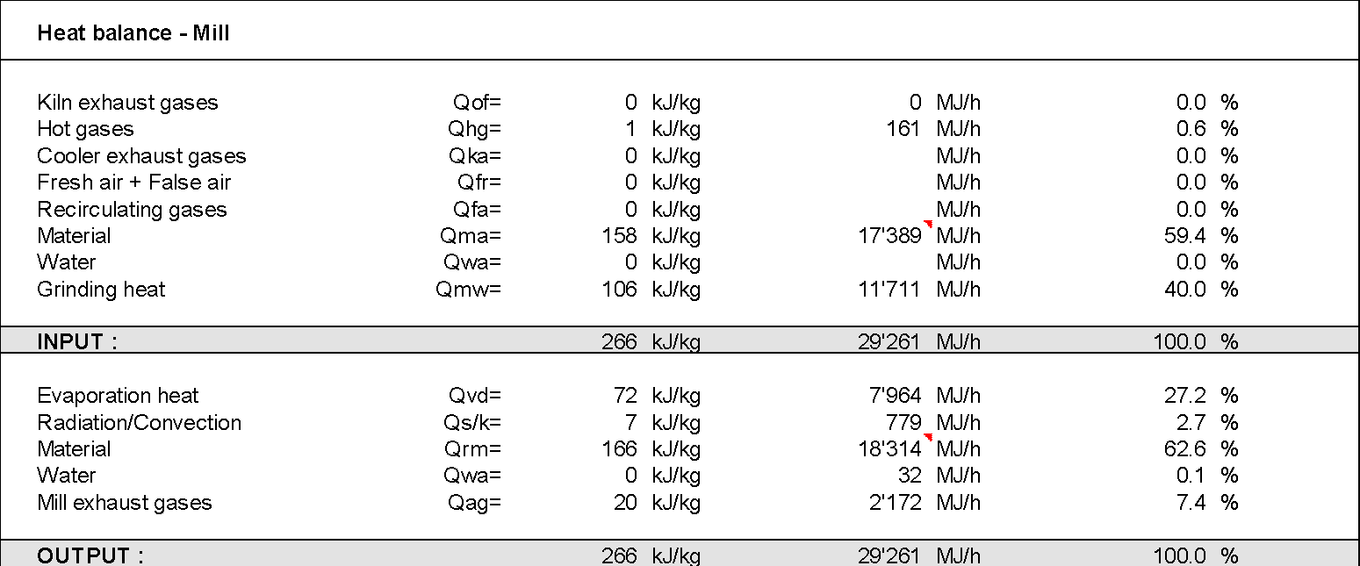
Conclusions - Drying
Heat Balance

Slide 21
Conclusion – Production Capacity Increase
For an production capacity increase, a roller press in semi-finish grinding mode has to be installed before the ball mill (2 stage grinding)
The required additional separators (e.g. V-separator & HES) allow to increase the feed moistures even above 10 %, if additional hot gases are used

Slide 22
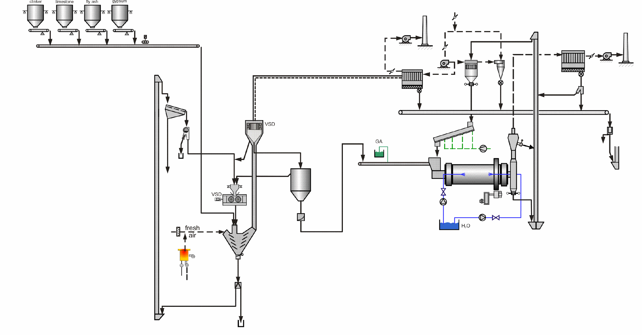
Conclusion – Production Capacity Increase

